Slide 1

Conversion of Regularization Expression to Deterministic finite automata
By
Kalva Bhageerath(RA2111026010072)
Pulaparthi Jagadeesh(RA2111026010112)
Kurella Chaitanya(RA2111026010132)

Slide 2
Objectives:
1. Understanding Regular Expressions (RE): Gain a comprehensive understanding of regular expression syntax, including operators such as *, +, |, and ().
2. Understanding Deterministic Finite Automata (DFA): Grasp the fundamental concepts of DFA, including states, transitions, and acceptance states.
3. Algorithm Development: Develop an algorithm to convert regular expressions into equivalent DFAs. Understand and implement conversion techniques like Thompson's construction or direct methods.
4. Handling Complex Regular Expressions: Develop strategies to handle complex regular expressions with nested parentheses, concatenation, and other advanced operators.
5. Implementation: Implement the developed algorithm in a programming language. Create a robust and efficient codebase for parsing regular expressions and constructing corresponding DFAs.
6. Testing: Conduct extensive testing to validate the correctness of the conversion process. Test the system with various types of regular expressions to ensure accurate DFA generation.
7. Optimization: Explore optimization techniques to improve the efficiency of the conversion algorithm, making it suitable for processing large or complex regular expressions.

Slide 3
Applications ::
1. **Compiler Design:** Regular expressions are commonly used in lexical analysis phase of compilers to tokenize source code. Converting regular expressions to DFAs allows efficient pattern matching, which is crucial for syntax analysis and code generation.
2. **Text Search and Pattern Matching:** Search engines, text editors, and other text processing tools utilize regular expressions to search for specific patterns in text. Converting regular expressions to DFAs enables fast and efficient text pattern matching.
3. **Network Security:** Intrusion detection systems and firewalls use regular expressions to define patterns for detecting malicious network traffic. Converting these regular expressions to DFAs allows real-time pattern matching, enhancing network security.
4. **Data Validation:** Regular expressions are used for validating input data such as email addresses, phone numbers, and credit card numbers. Converting these regular expressions to DFAs ensures accurate and efficient validation of user input.
5. **Lexical Analysis in Natural Language Processing:** Regular expressions are employed in natural language processing tasks, such as tokenization and part-of-speech tagging. Converting regular expressions to DFAs aids in efficient processing of textual data.

Slide 4
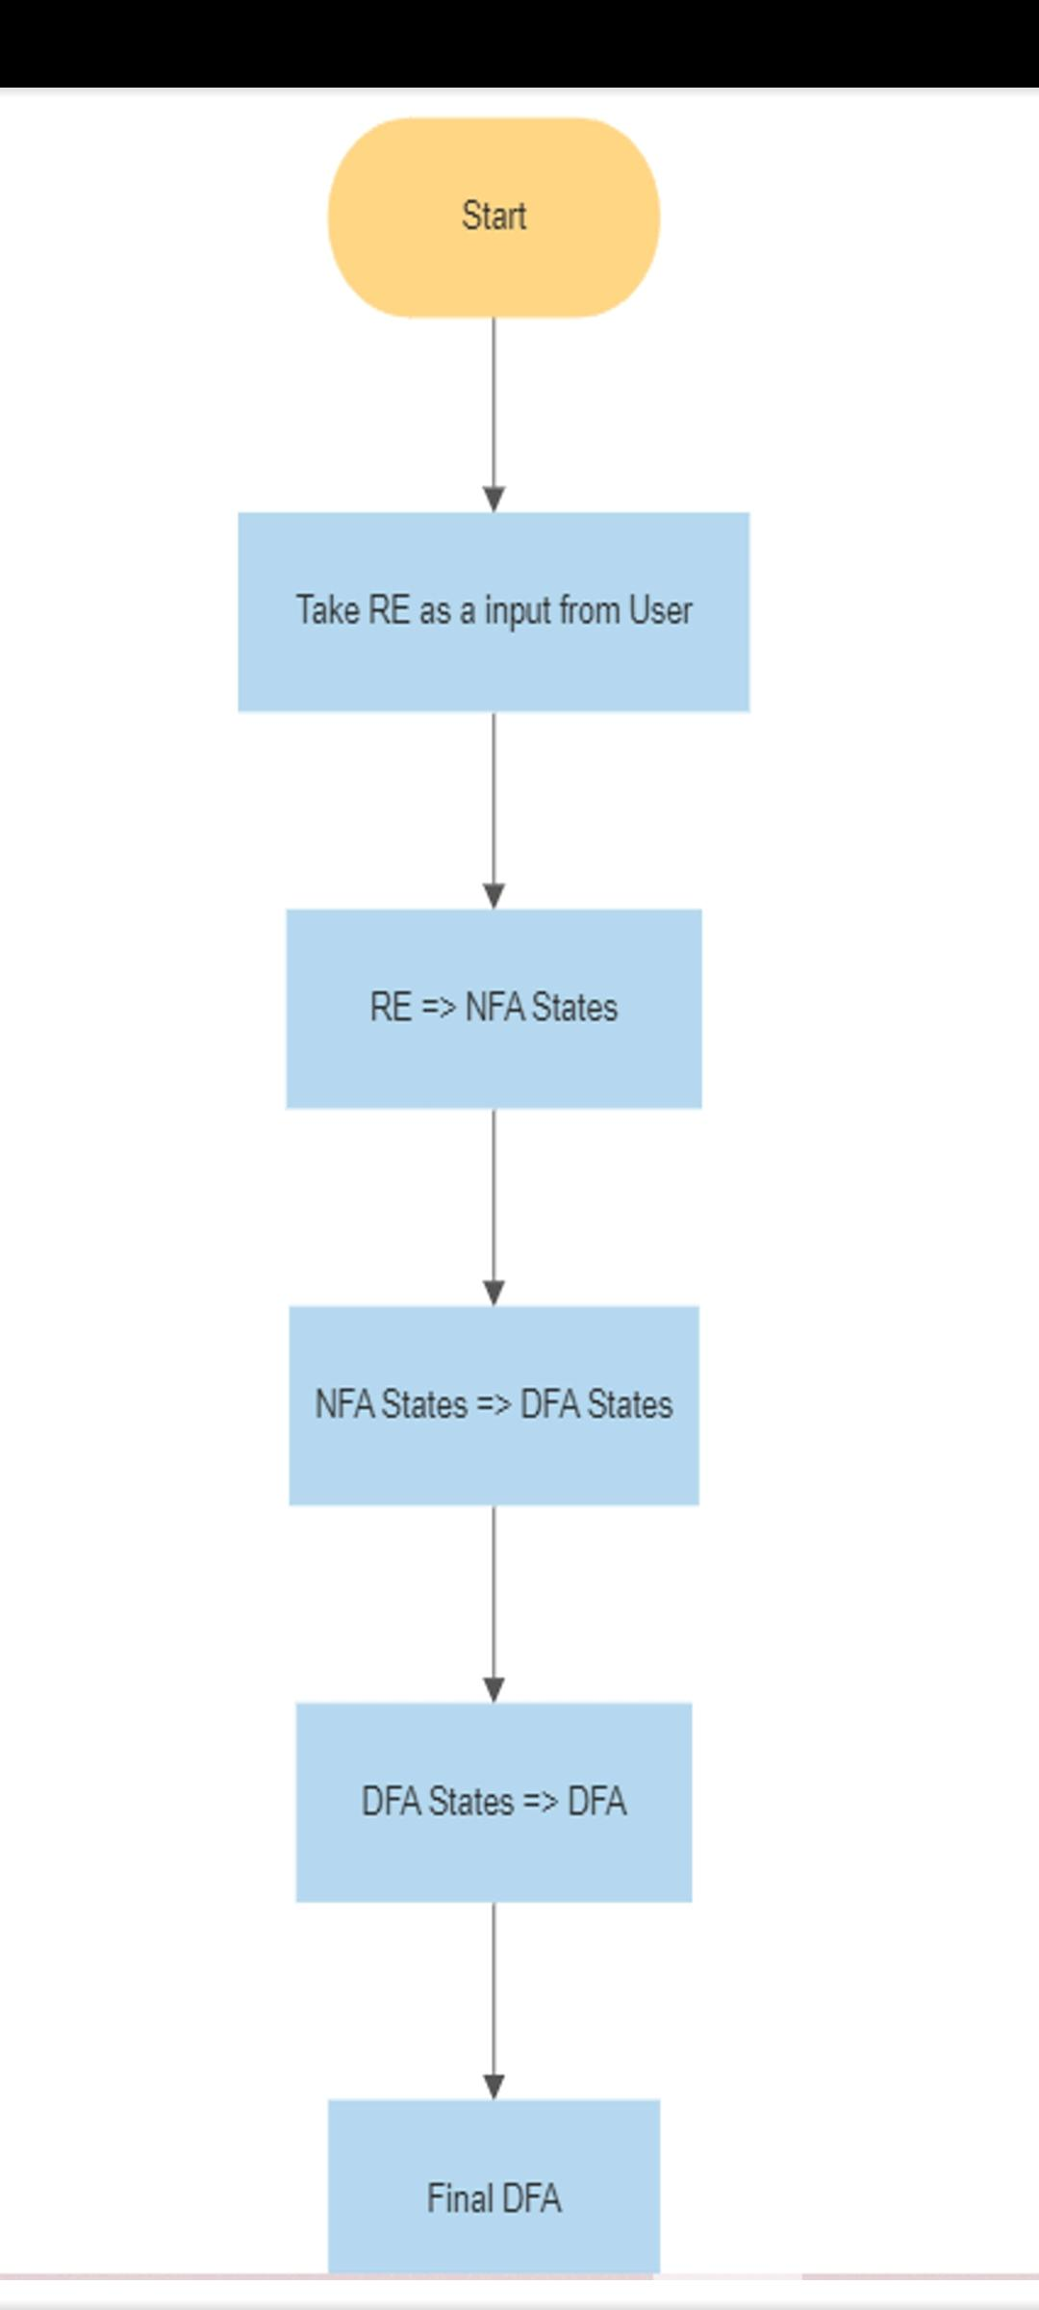
Flow Chart:

Slide 5
Explanation:
Imported the tkinter module to create a graphical user interface (GUI).
Created a DFA class to represent the deterministic finite automaton.
Added an alphabet parameter to the DFA constructor to specify the alphabet.
Implemented a convert_from_regex method in the DFA class to convert a regular expression to a DFA.
Used a stack-based algorithm in the convert_from_regex method to convert the regular expression to a non-deterministic finite automaton (NFA).
Handled the case where the input is None in the convert_from_nfa method.
Modified the __str__ method of the DFA class to display the DFA representation correctly.
Created a GUI using tkinter to take user input and display the result.
Added a label and entry field for the regular expression in the GUI.
Added a convert button in the GUI to trigger the conversion process.
Implemented the convert_to_dfa function to handle the conversion process when the convert button is clicked.
Handled the case where the regular expression is empty in the convert_to_dfa function.
Displayed an error message using a message box if an exception occurs during the conversion process.
Added a text box in the GUI to display the resulting DFA.
Started the main event loop to run the GUI application.

Slide 6
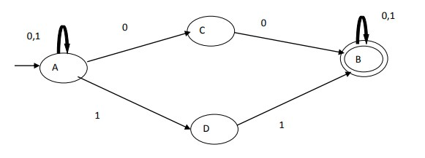
Example: Construct of Deterministic Finite Automata (DFA) from following regular expression (0+1)*(00+11) (0+1)*

Slide 7
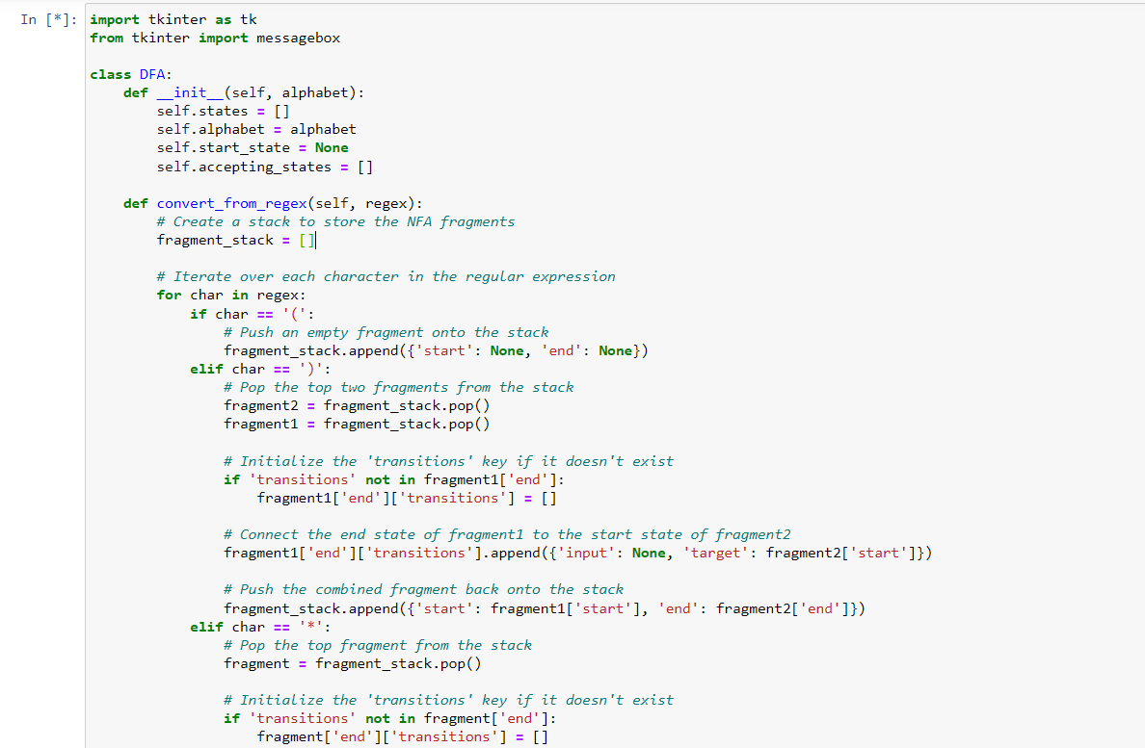
Code:

Slide 8
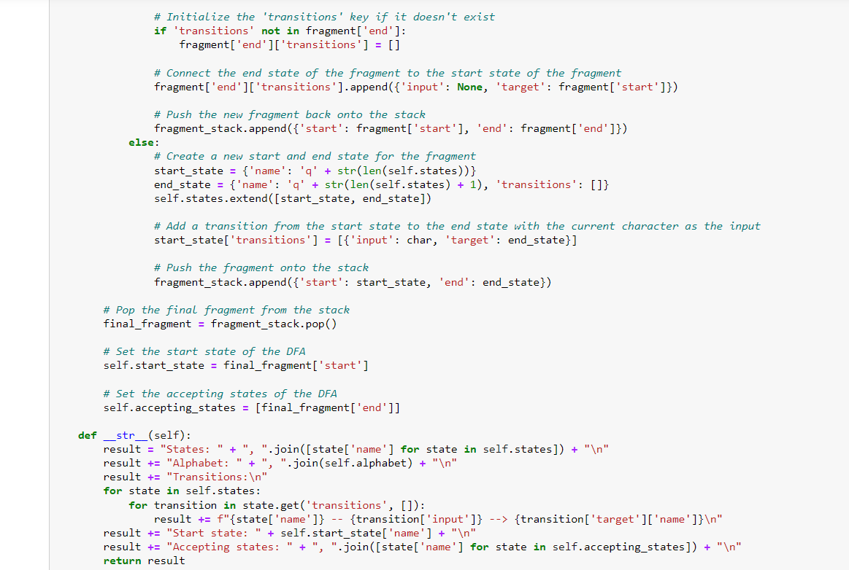

Slide 9
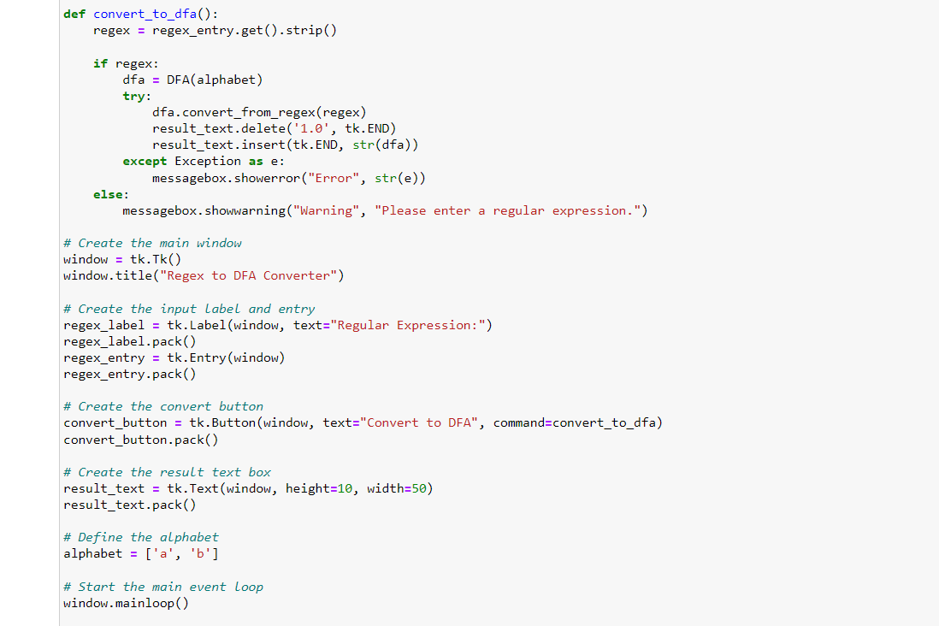

Slide 10
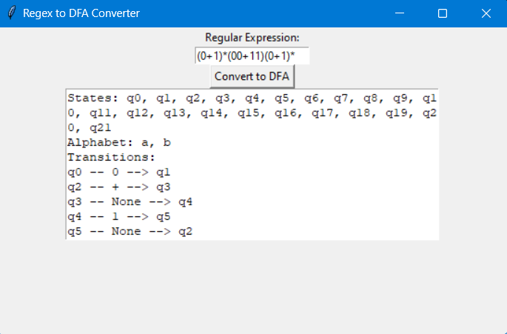
Output:

Slide 11
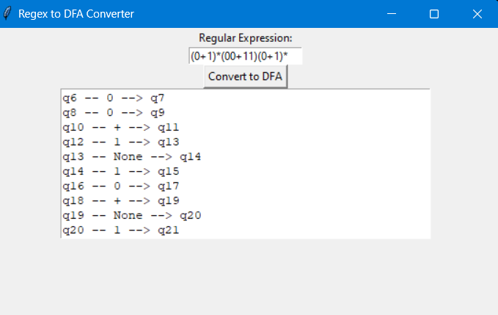
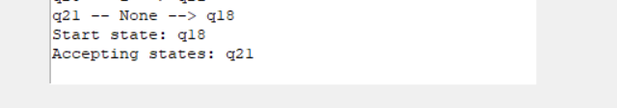

Slide 12
Conclusion:
In conclusion, the code has been successfully modified to include a graphical user interface (GUI) and to convert regular expressions to deterministic finite automata (DFAs). The DFA class has been implemented to represent the DFA and handle the conversion process. The GUI allows the user to enter a regular expression, click a convert button, and view the resulting DFA in a text box. Error handling has also been implemented to display error messages when necessary. These changes enhance the usability and functionality of the code, making it easier for users to convert regular expressions to DFAs.

Slide 13
Contribution:
PPT- Kalva Bhageerath
Code-DFA Conversion-Kurella Chaitanya
GUI Conversion-Pulaparthi Jagadeesh

Slide 14
GitHub Link:
https://github.com/Bhageerath-Kalva/regex-to-dfa

